Slide 1
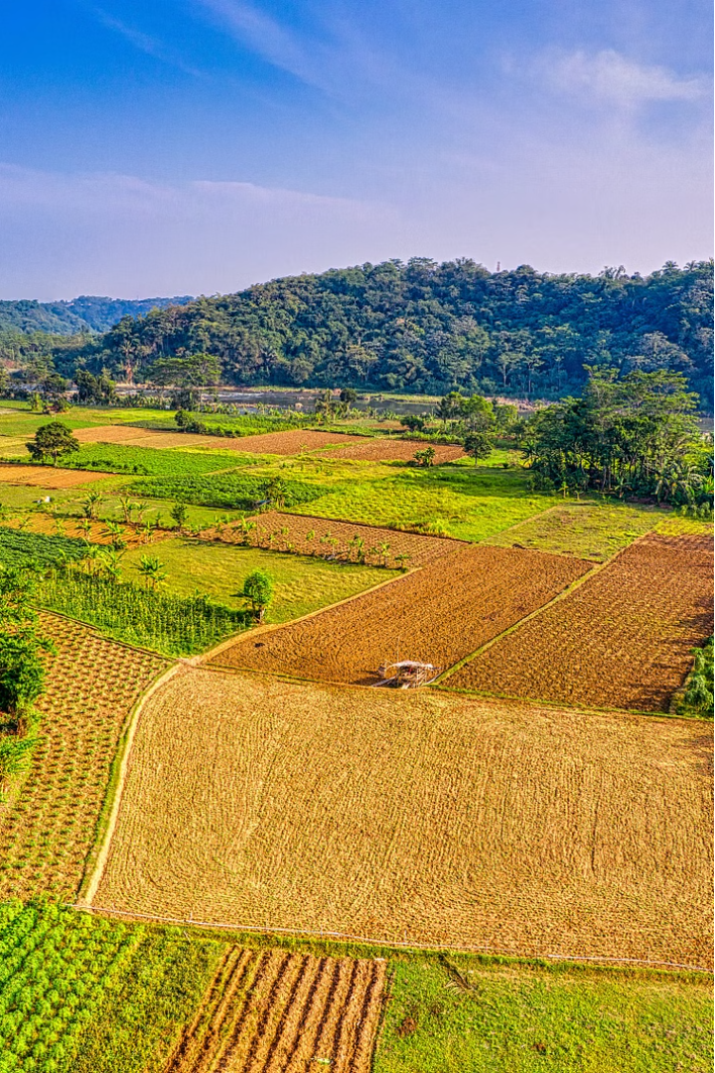


Agricultural Management System
Developed by
Aakil Shihaf (2116210701004)
Alwyn Jose L (2116210701025)
Our Agricultural Management System aims to revolutionize farming practices through innovative technology and data-driven insights.

Slide 2
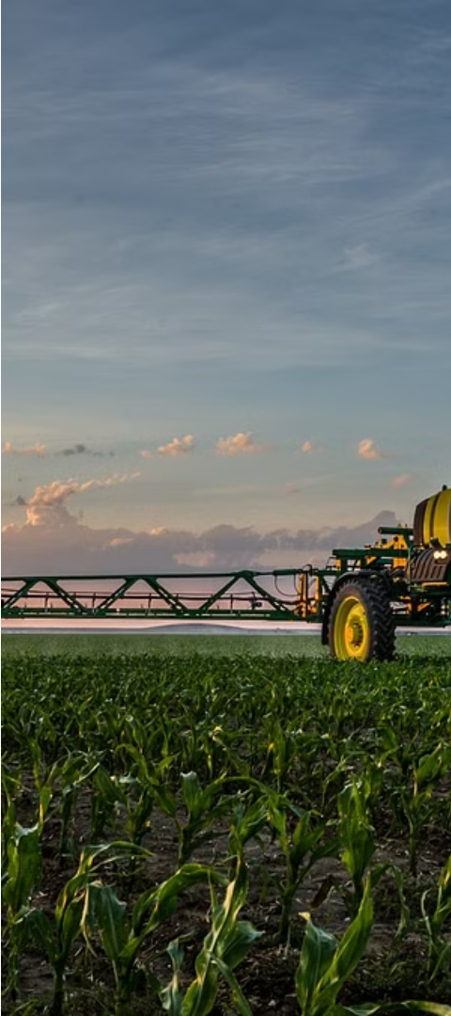
Problem Statement
1
Unpredictable Weather
2
Yield Fluctuations
Inconsistent crop yields can lead to financial instability and challenges in meeting market demands.
Farmers often struggle with the uncertainty of weather patterns, making it difficult to plan and optimize their operations.
3
Inefficient Fertilizer Use
Improper application of fertilizers can result in waste, environmental damage, and suboptimal plant growth.

Slide 3
Abstract
Rainfall Prediction
Yield Prediction
Fertilizer Recommendation
By analyzing historical data, soil conditions, and weather patterns, our system can provide accurate predictions of crop yields, helping farmers optimize their resources.
Our system utilizes advanced AI and machine learning algorithms to forecast rainfall patterns, enabling farmers to plan their activities more effectively.
Our system offers personalized fertilizer recommendations based on soil analysis and plant growth requirements, ensuring efficient and sustainable usage.

Slide 4
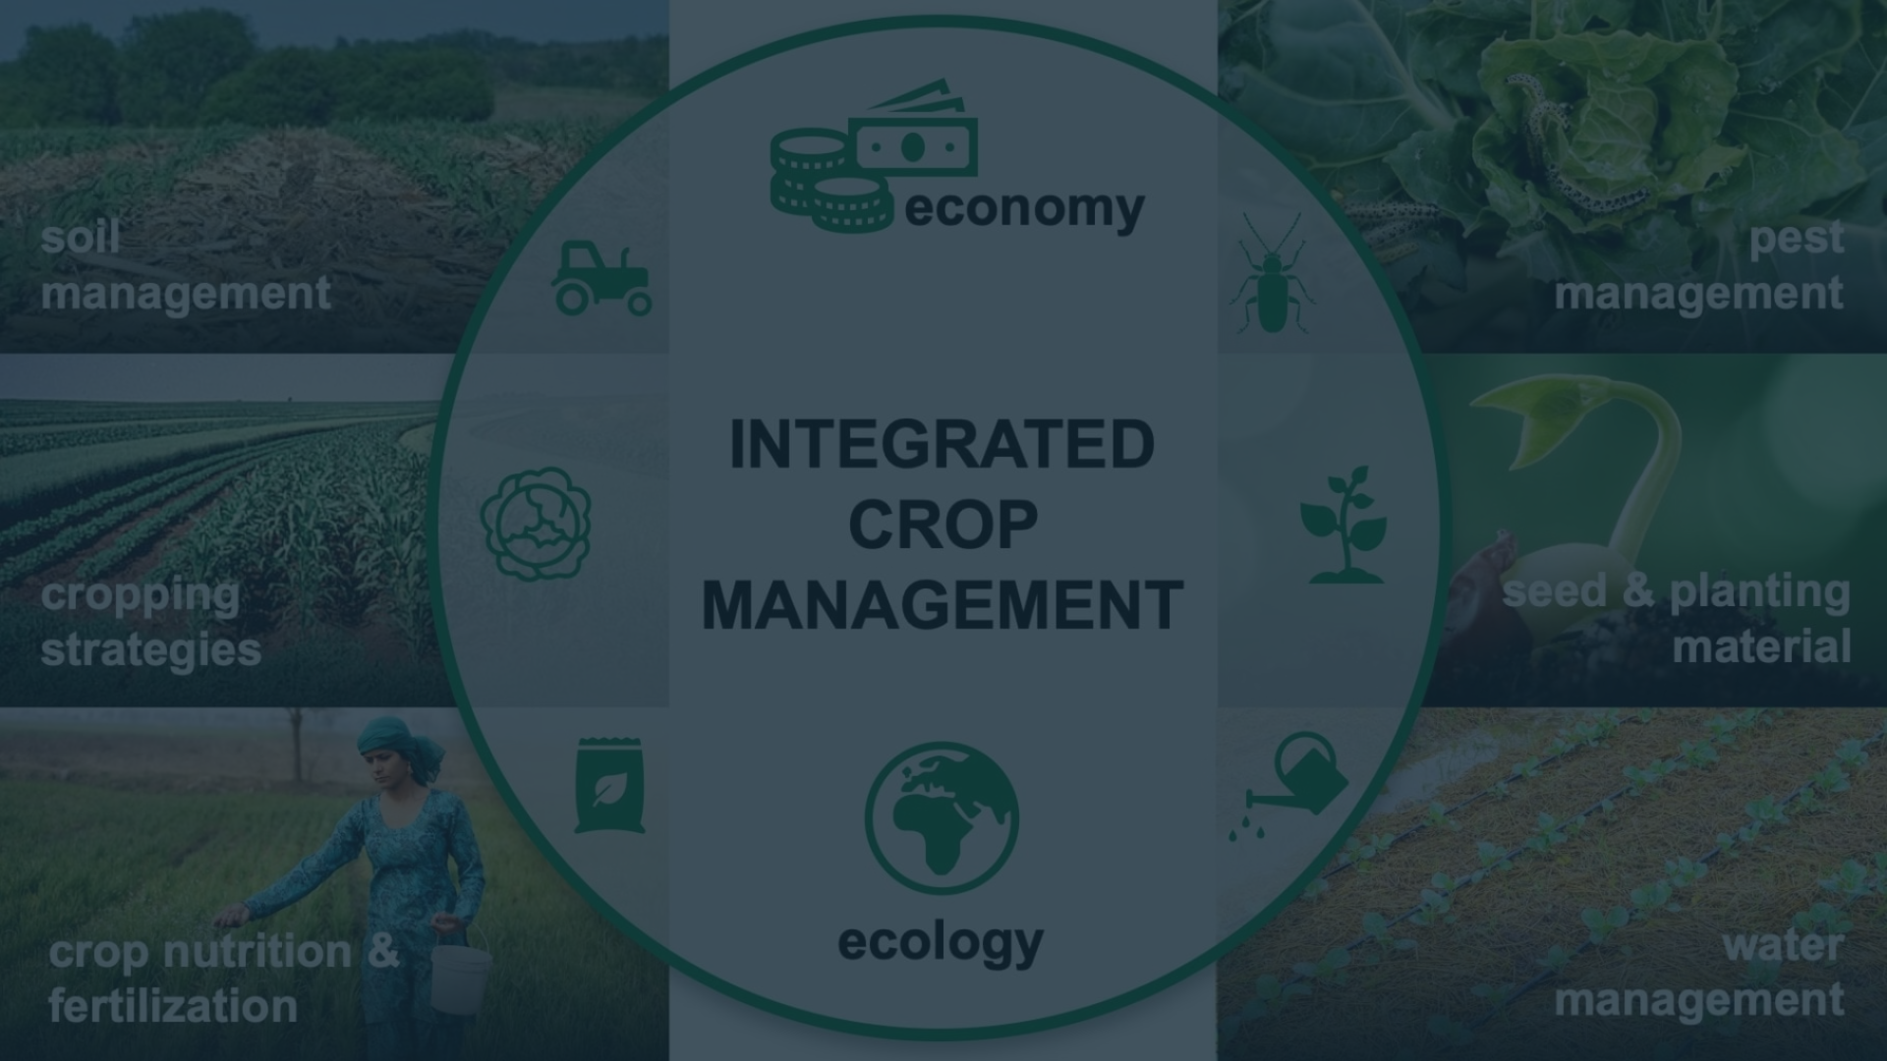
System Architecture
Data Collection
User Interface
Our system gathers real-time data from various sensors, weather stations, and historical records to build a comprehensive database.
A user-friendly web-based platform presents the insights and recommendations in an accessible and actionable format.
1
2
3
Data Analysis
Advanced algorithms and AI models analyze the collected data to generate insights and predictions for farmers.

Slide 5
Rainfall Prediction
Machine Learning Models
Hyper-local Forecasting
Our system employs state-of-the-art machine learning algorithms to analyze historical weather data and predict future rainfall patterns.
The system provides highly localized rainfall predictions, enabling farmers to make informed decisions for their specific regions.
Real-time Updates
Proactive Alerts
Farmers can access the latest rainfall predictions and adjust their plans accordingly, ensuring optimal crop management.
The system sends timely notifications to farmers, enabling them to prepare for adverse weather conditions and mitigate potential risks.

Slide 6
Yield Prediction
Data-driven Models
Customized Recommendations
Adaptive Algorithms
Our yield prediction models integrate historical yield data, soil characteristics, and weather patterns to forecast crop production.
The models continuously learn and adapt to new data, ensuring accurate and up-to-date yield predictions over time.
The system provides personalized yield predictions based on the specific needs and conditions of each farm, helping farmers optimize their operations.

Slide 7
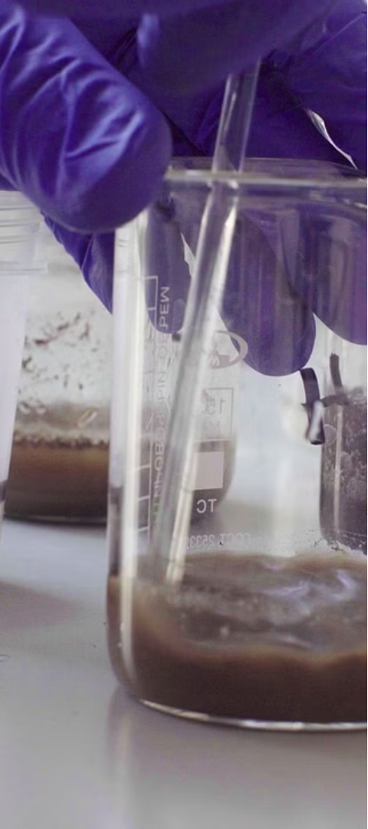



Fertilizer Recommendation
Soil Analysis
Our system conducts comprehensive soil tests to determine the nutrient composition and requirements for optimal plant growth.
Recommendation Engine
The system analyzes the soil data and provides tailored recommendations for the right type and amount of fertilizers to apply.
Real-time Monitoring
Farmers can track the impact of the recommended fertilizers and make adjustments as needed for maximum effectiveness.

Slide 8




Conclusion
Weather Prediction
Yield Optimization
Sustainable Farming
Efficient Operations
Accurate rainfall forecasting for better planning and risk mitigation.
Data-driven predictions to maximize crop production and profitability.
Personalized fertilizer recommendations for efficient and eco-friendly practices.
Integrated system for streamlined decision-making and resource management.

